Slide 1
Bulk Forming Processes

Slide 2
Basic Processes
Rolling
Forging
Extrusion
Wire, Rod and Tube Drawing
Cold Forming, Cold Extrusion and Impact Extrusion
Piercing
Other Processes
Surface Improvement by Deformation

Slide 3
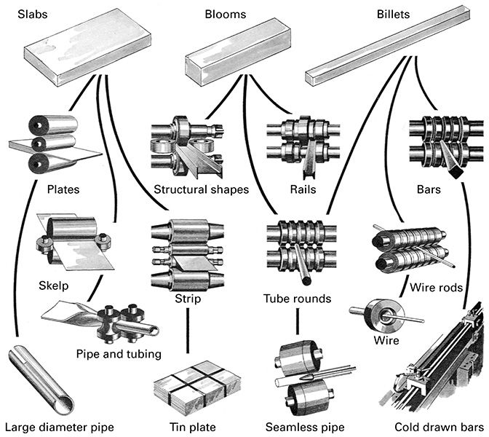
Starting Stock

Slide 4
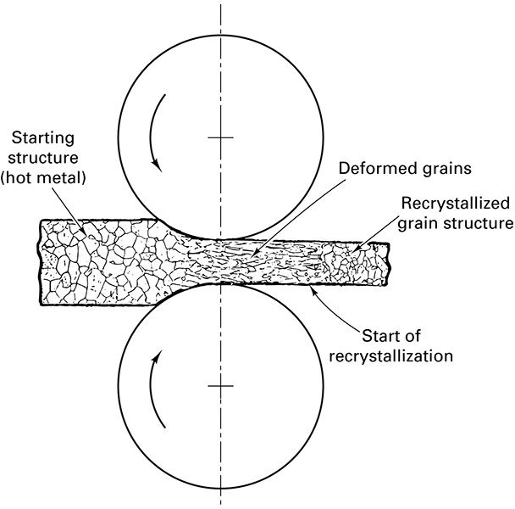
Massive Deformations without Annealing

Slide 5
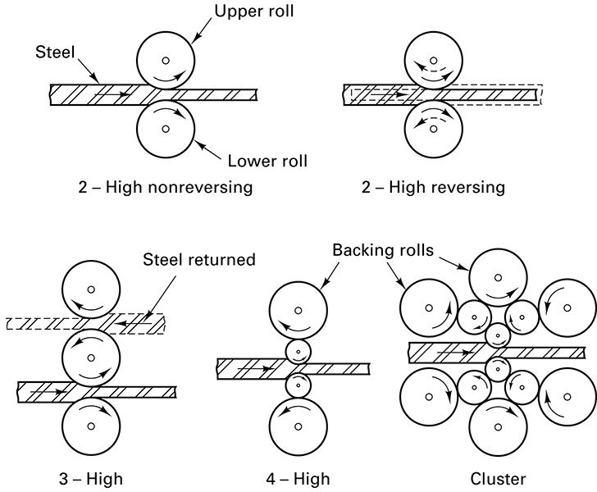
Configuration of Rolls

Slide 6
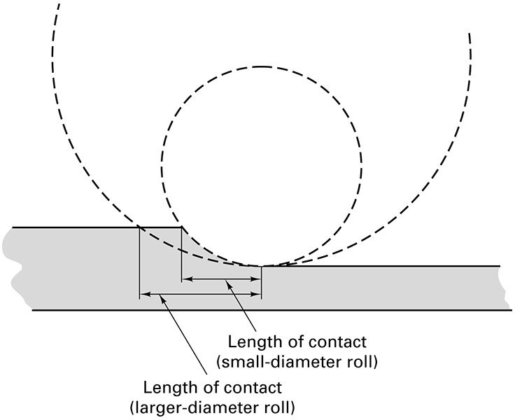
Effect of Roll Diameter

Slide 7
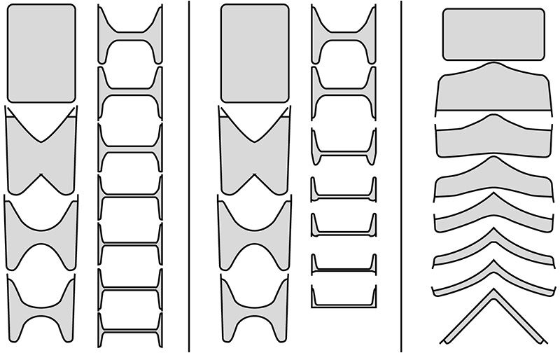
Structural Shapes from Multiple Contoured Rolls

Slide 8
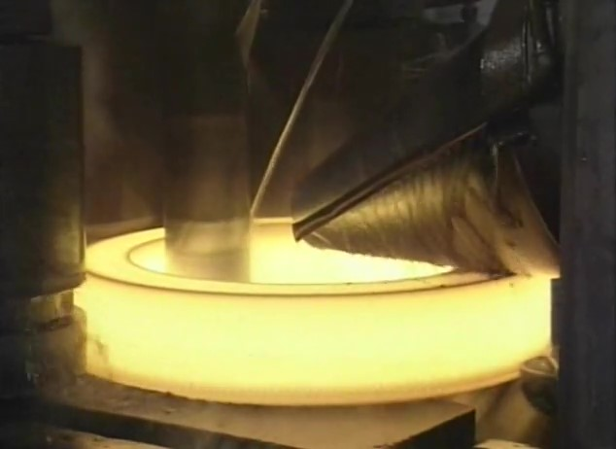
Watch Video Here
Notes:
Ring Rolling

Slide 9
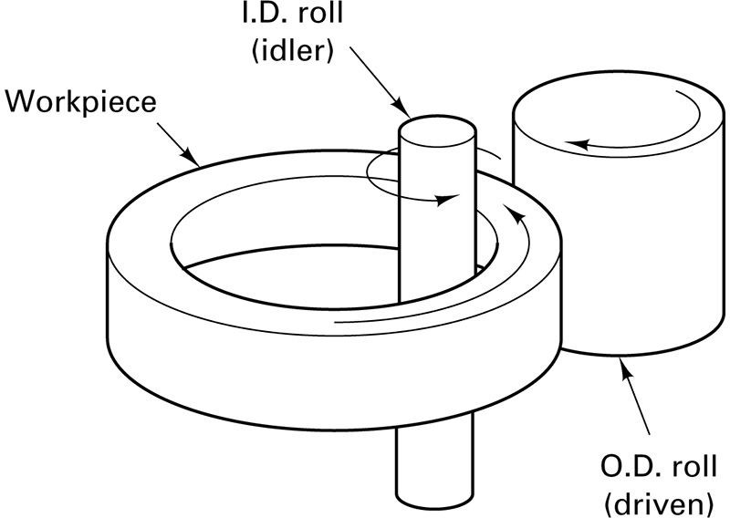
Ring Rolling

Slide 10
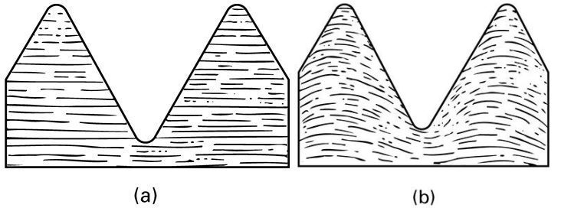
Thread Rolling

Slide 11
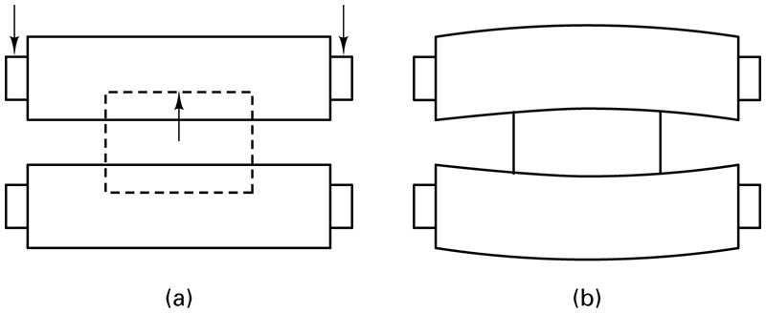
Loading a Rolling Mill Roll

Slide 12
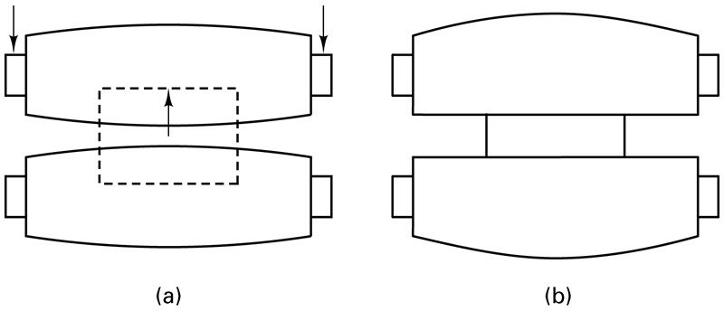
Use of Crowned Roll to Compensate for Roll Flexure

Slide 13
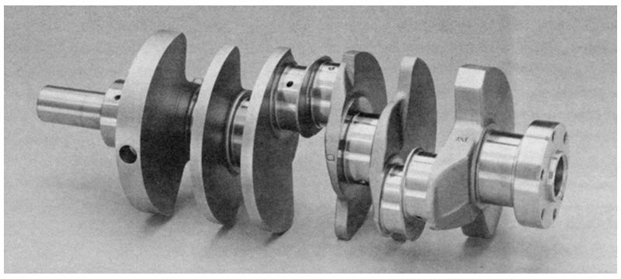
Forged Crankshaft

Slide 14
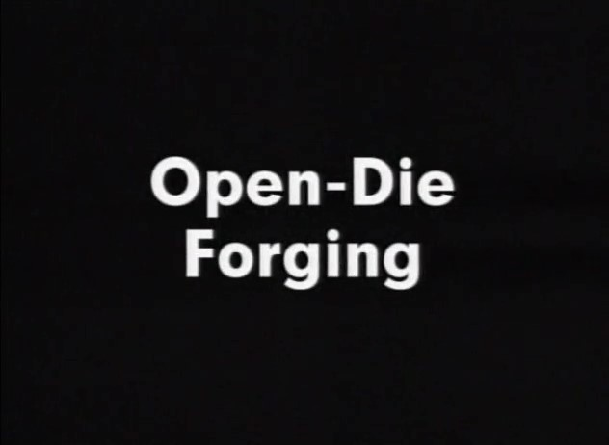
Watch Video Here
Notes:
Open Die Forging

Slide 15
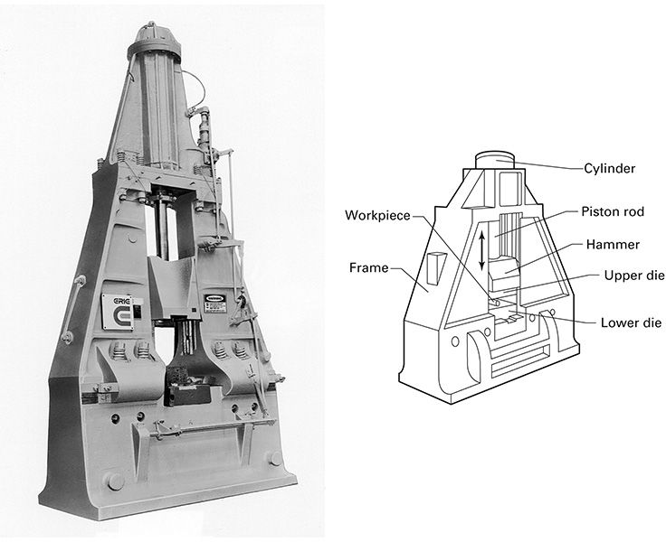
Hammer Forging Machine

Slide 16
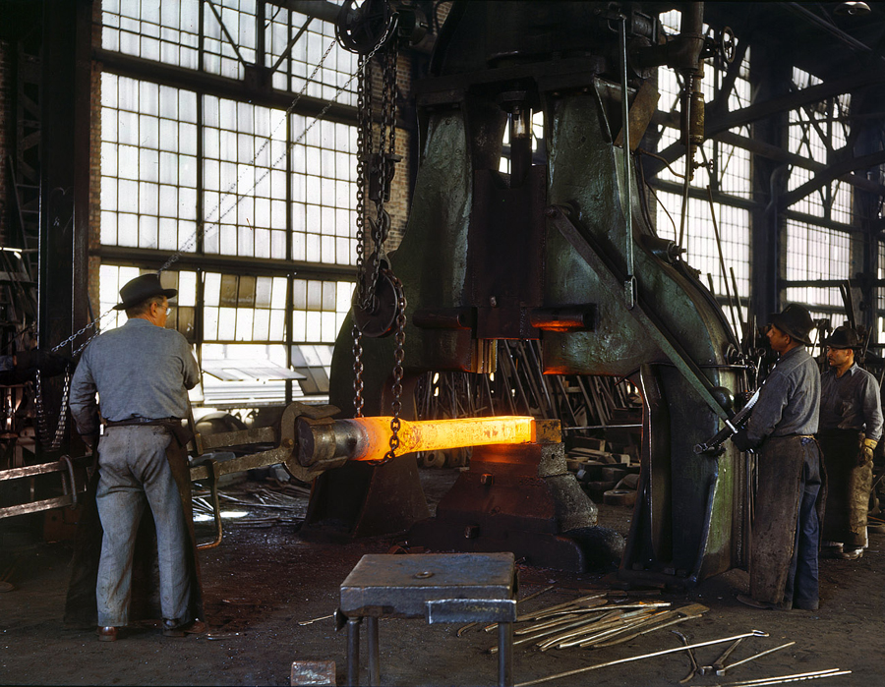
March 1943. "Santa Fe R.R. shops, Albuquerque. Hammering out a drawbar on the steam drop hammer in the blacksmith shop."

Slide 17
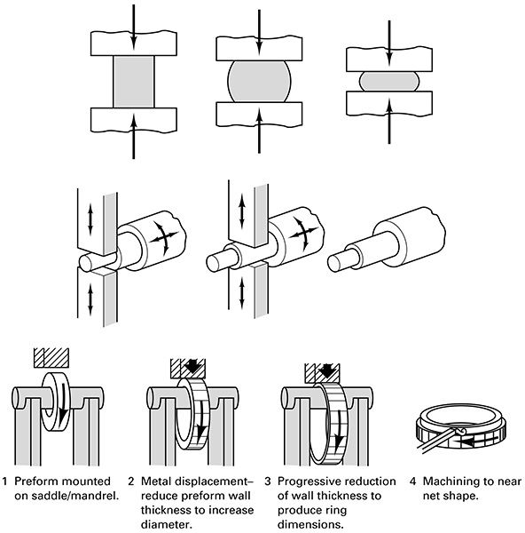
Orienting Workpiece for Desired Shape

Slide 18
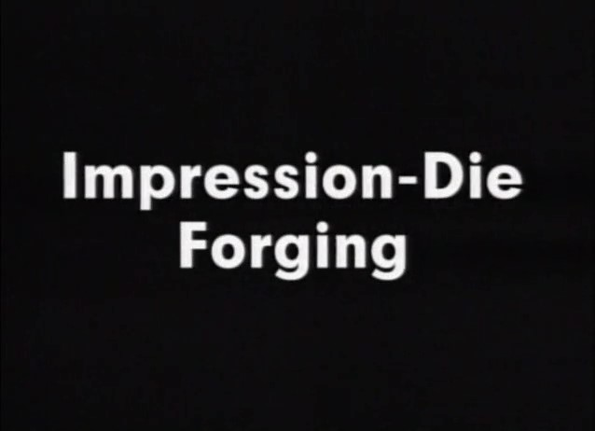
Watch Video Here
Notes:
Impression Die Forging

Slide 19
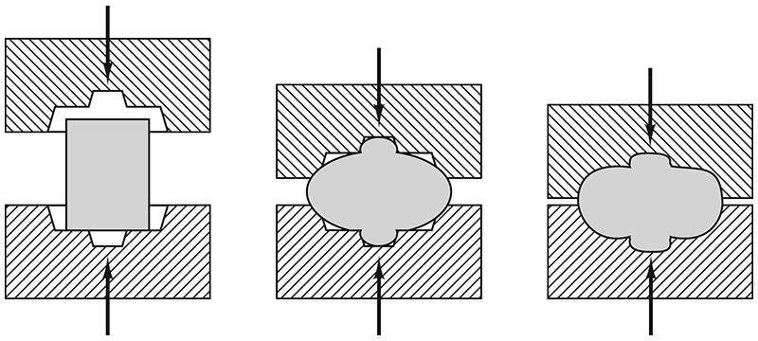
Impression-die (Closed-die) Hammer Forging

Slide 20
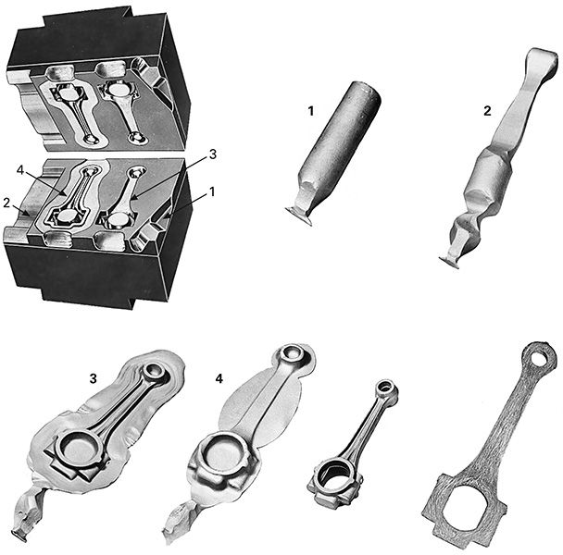
Impression Die Forged Connecting Rod

Slide 21
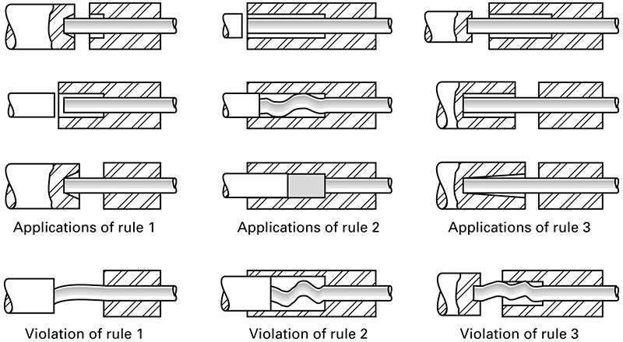
Rules Governing Upset Forging
The length of unsupported metal that can be gathered or upset in one blow without injurious buckling should be limited to three times the diameter of the bar.
Lengths of stock greater than three times the diameter may be upset successfully provided that the diameter of the upset is not more than 1 times the diameter of the bar.
In an upset requiring stock length greater than three times the diameter of the bar, and where the diameter of the cavity is not more than 1 times the diameter of the bar (the conditions of rule 2), the length of unsupported metal beyond the face of the die must not exceed the diameter of the bar.

Slide 22
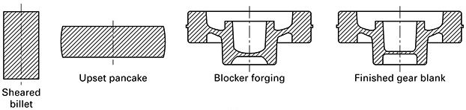
Automatic (high-speed) Hot Forging

Slide 23
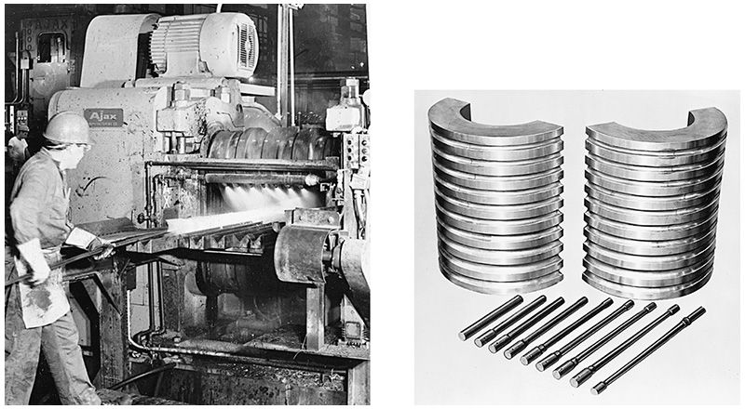
Roll Forging

Slide 24
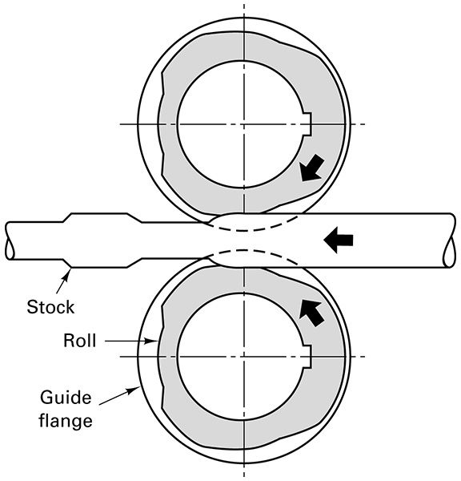
Roll Forging Contoured Shape

Slide 25
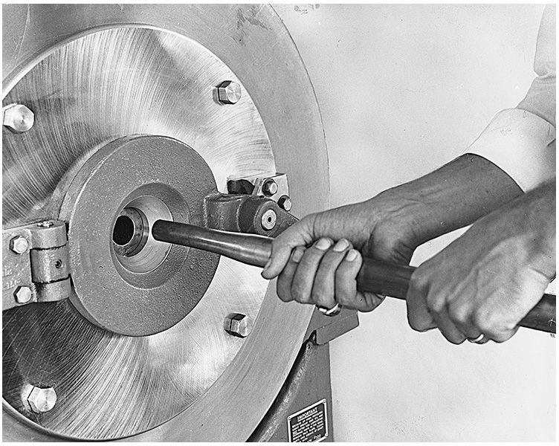
Rotary Hammer Swaging

Slide 26
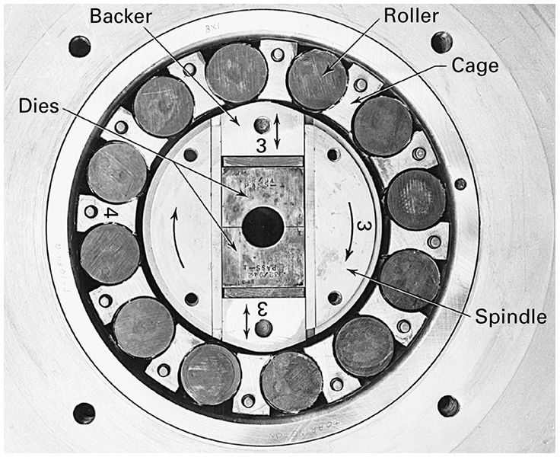
Rotary Swaging Machine

Slide 27
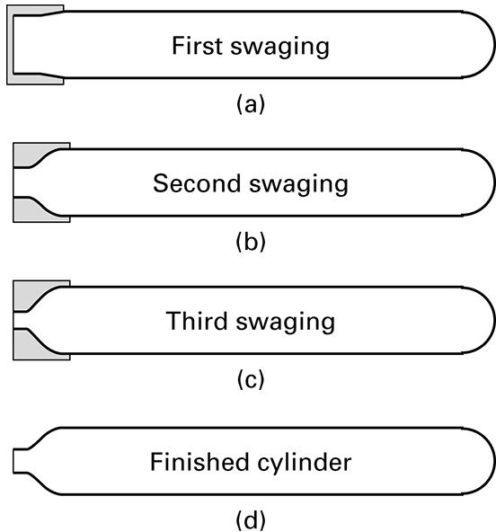
Tube Swaging a Neck for Gas Cylinder

Slide 28
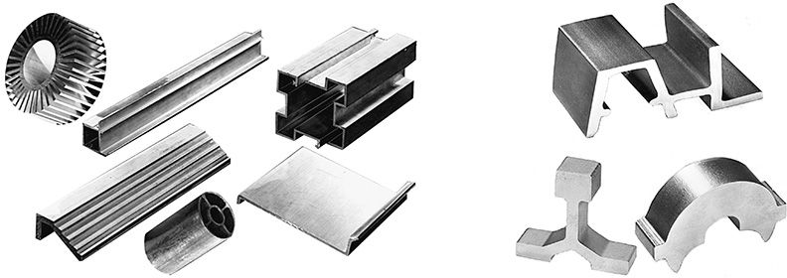
Extruded Shapes

Slide 29
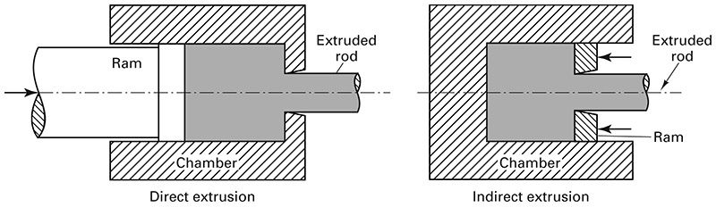
Direct or Indirect Extrusion

Slide 30
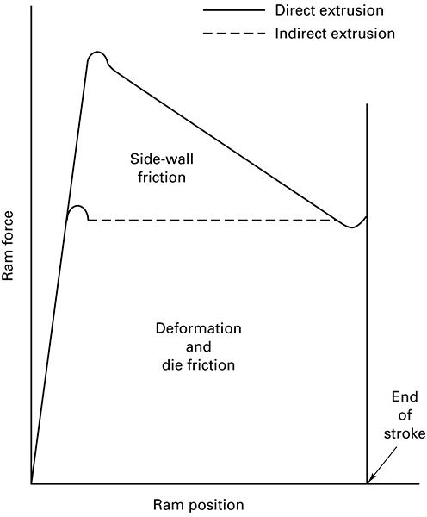
Work Comparison – Direct vs. Indirect Extrusion

Slide 31
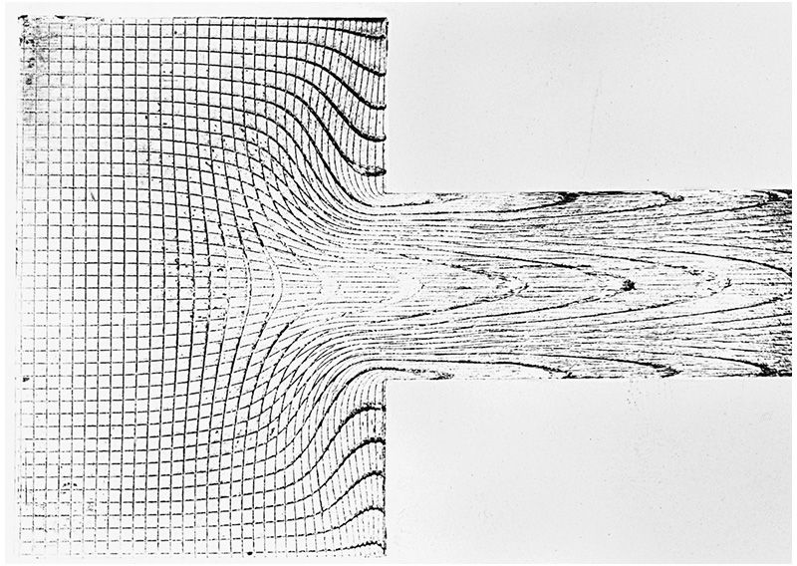
Metal Flow in Extrusion

Slide 32
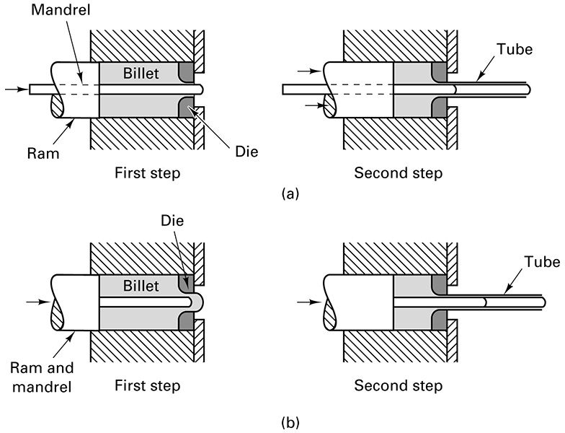
Hollow Shapes Extruded

Slide 33
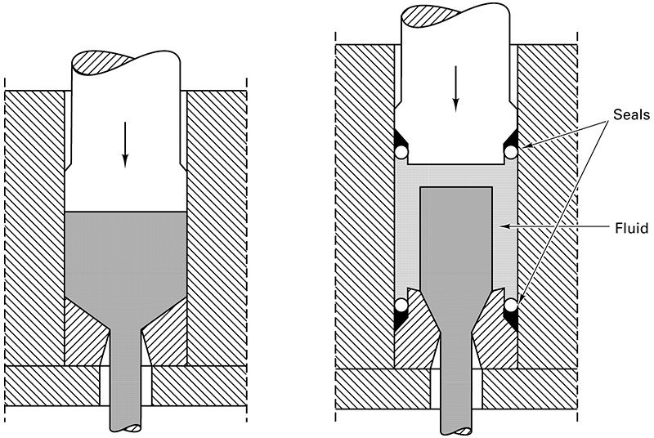
Conventional vs. Hydrostatic Extrusion

Slide 34
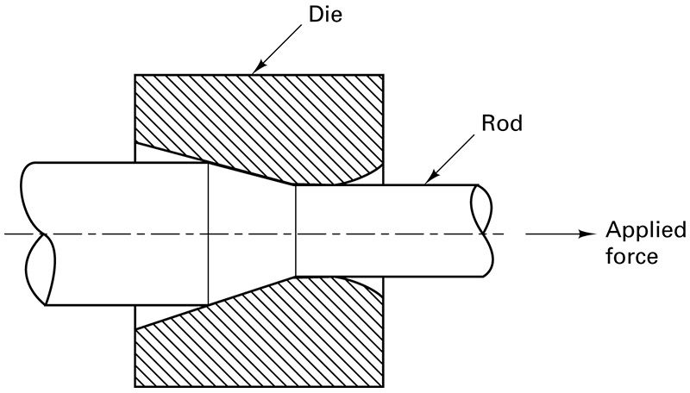
Rod (Bar) Drawing

Slide 35
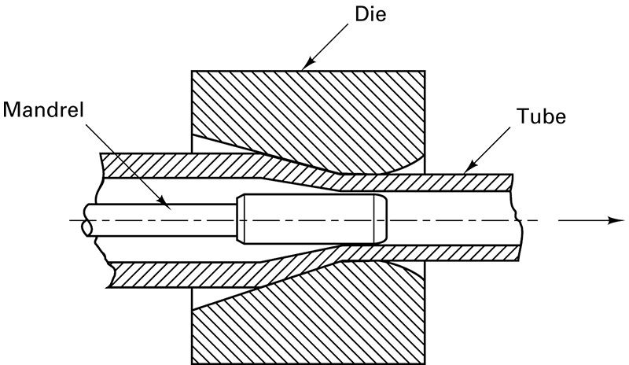
Tube Drawing

Slide 36
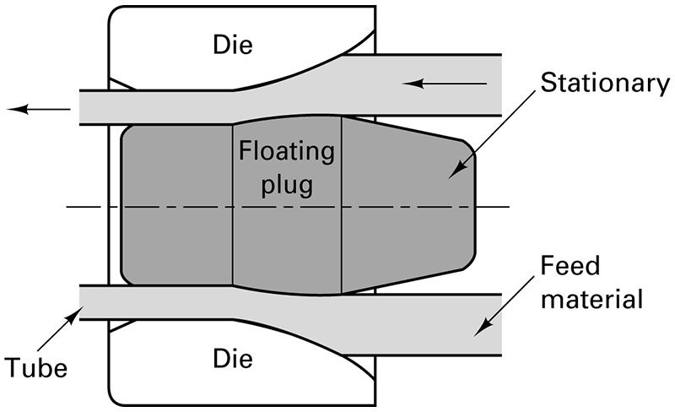
Tube Drawing with Floating Plug

Slide 37
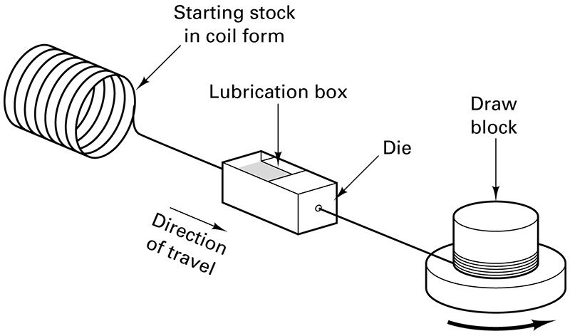
Wire Drawing Process

Slide 38
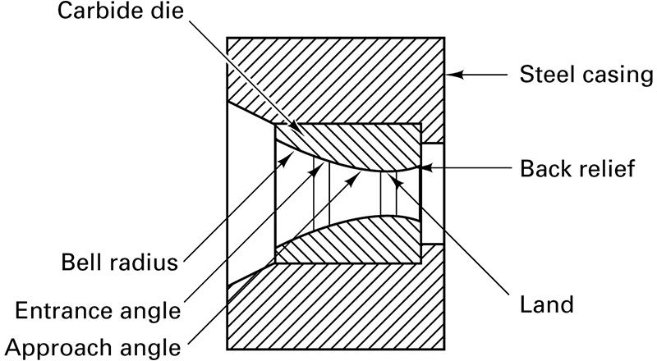
Carbide Wire-Drawing Die

Slide 39
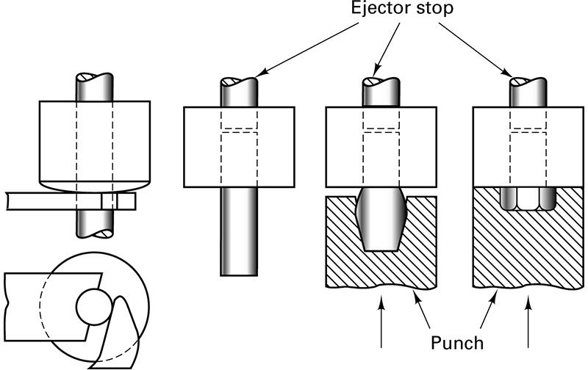
Cold Heading Steps

Slide 40
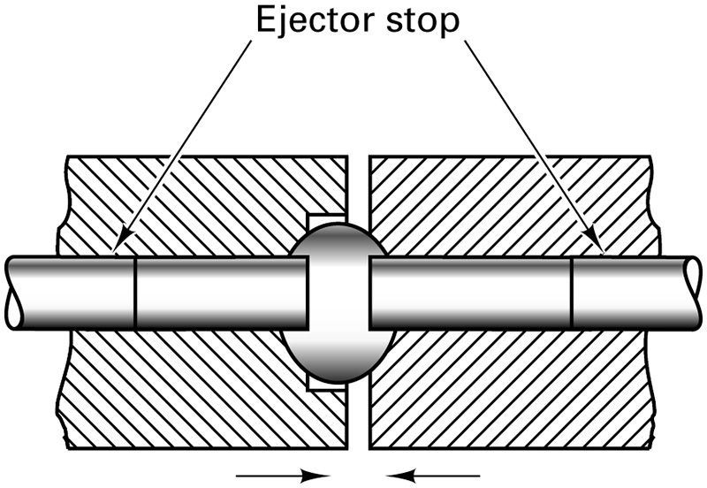
Upsetting Process

Slide 41
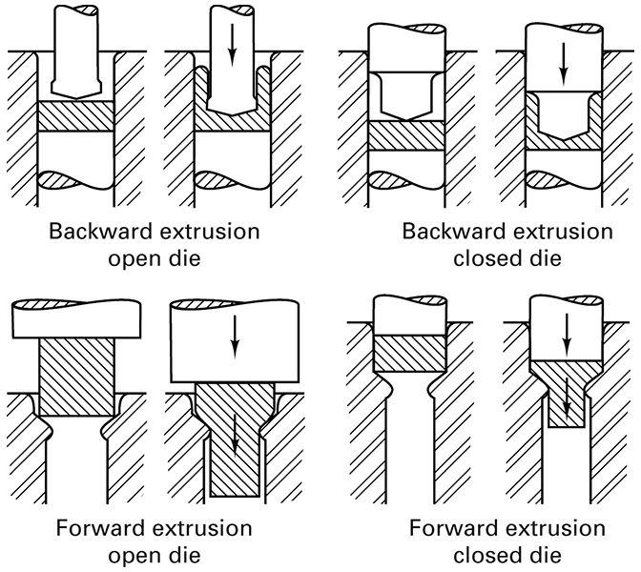
Backward and Forward Extrusion

Slide 42
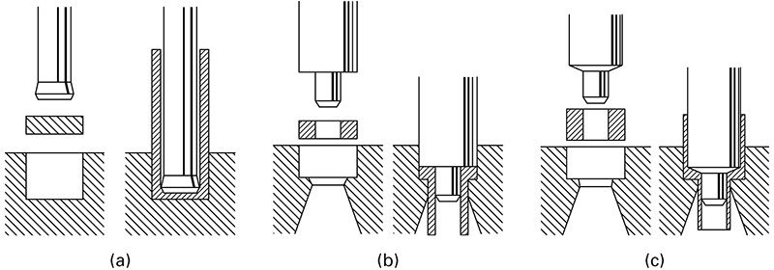
Backward and Forward Extrusion

Slide 43
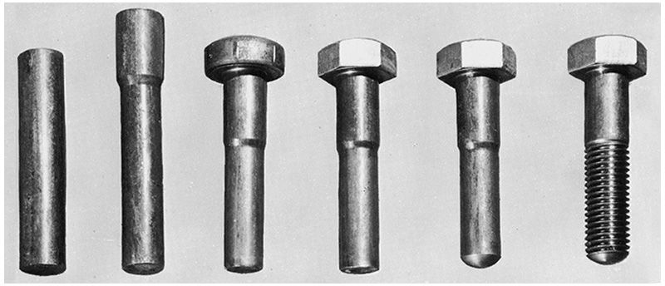
Cold Extrusion, Cold Heading, Thread Rolling

Slide 44
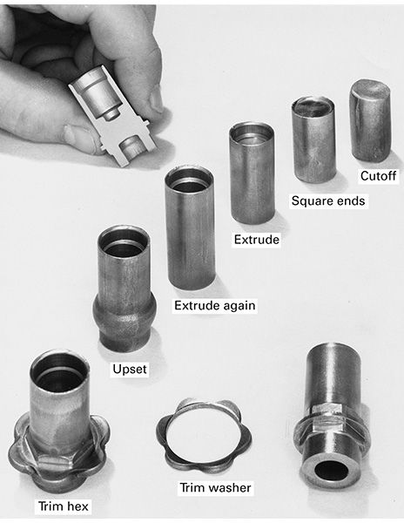
Cold Forming Sequence

Slide 45
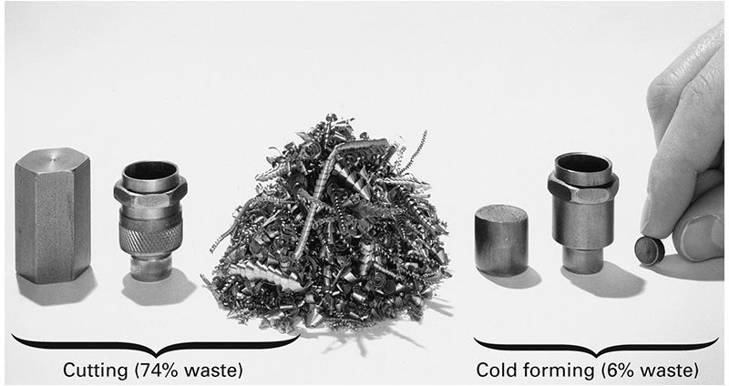
Forming Spark Plug Body

Slide 46
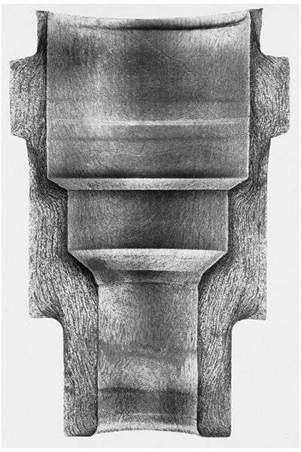
Grain Flow in Spark Plug Body

Slide 47
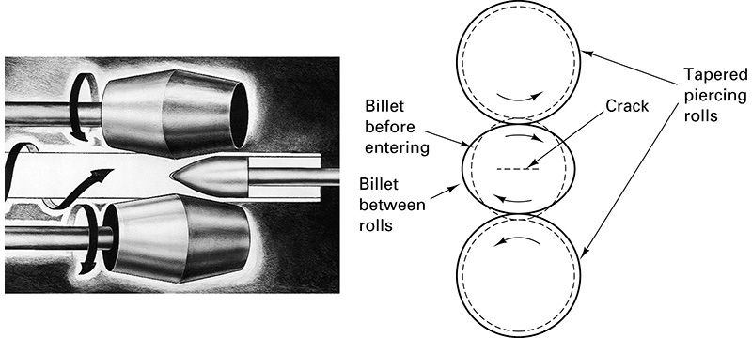
Thick-Walled Seamless Tubing by Piercing

Slide 48
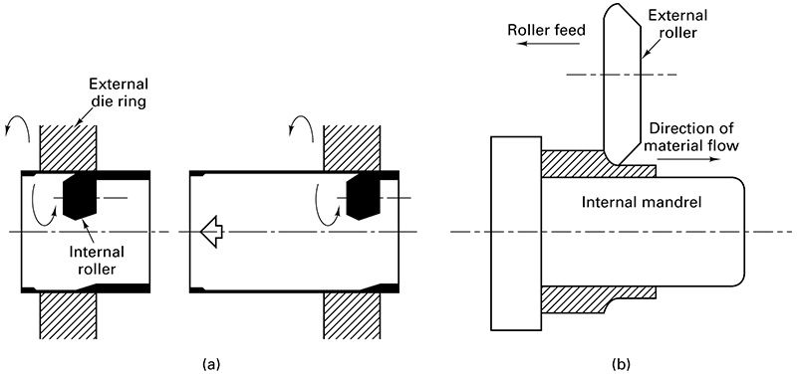
Roll Extrusion

Slide 49
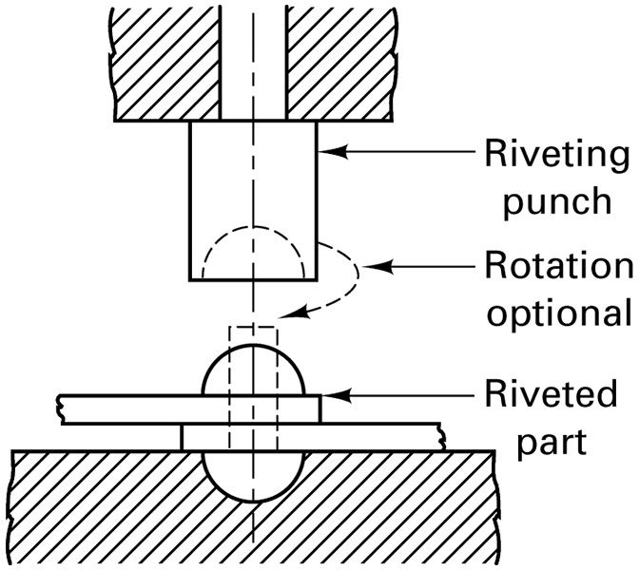
Riveting

Slide 50
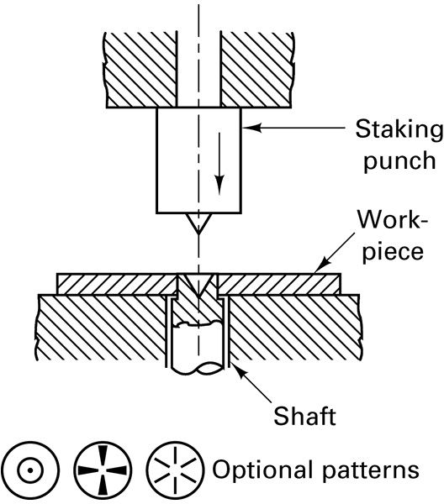
Staking

Slide 51
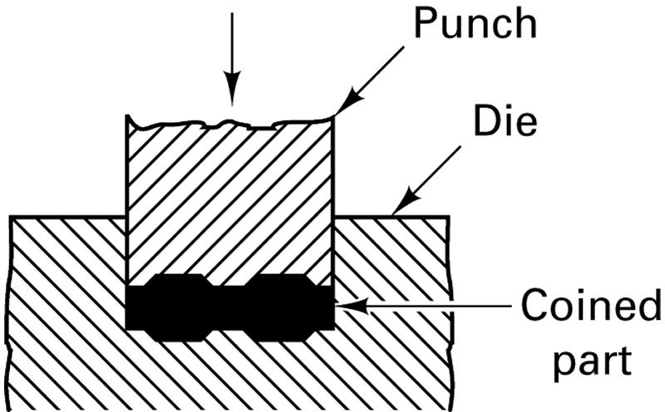
Coining

Slide 52
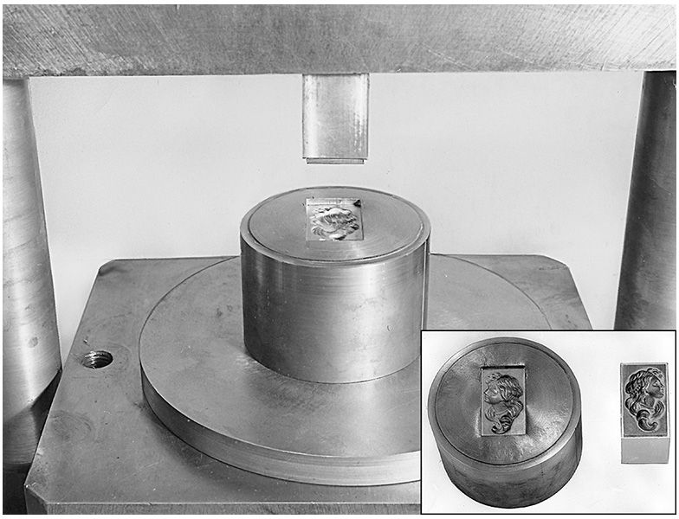
Hubbing

Slide 53

Roller Burnishing

